Slide 1

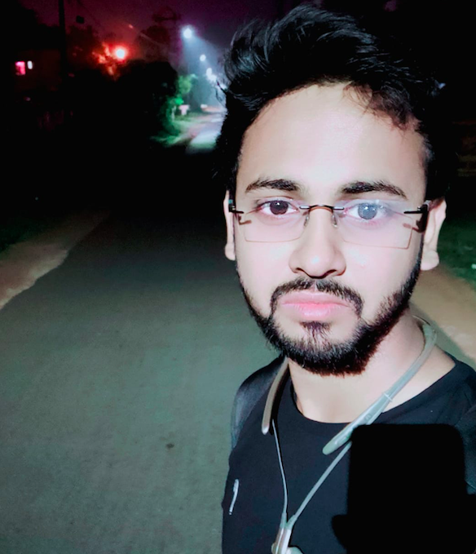




WEBINAR
ON
BENGAL COLLEGE OF ENGINEERING AND TECHNOLOGY
BASIC ETHICAL HACKING
AND
SQL INJECTION ATTACK
SPEAKER
Enhance Your Knowledge About Cyber Security
Most demanded tech career
e-Certificate will be Provided for all participants
: 09/01/2022
Vatsal Vinit
: 10:30 a.m.
CO-FOUNDER :
CYBERCELL BCET
: 9883225047
: cybercell.bcet@gmail.com

